Slide 1

Loan Approval Prediction
Group L
Erin, Rick, Zheng

Slide 2
Agenda
1. Feature Engineering
2. Early State Model Results
3. Feature Creation & Feature Selection
4. final results(Roc curve, results )

Slide 3
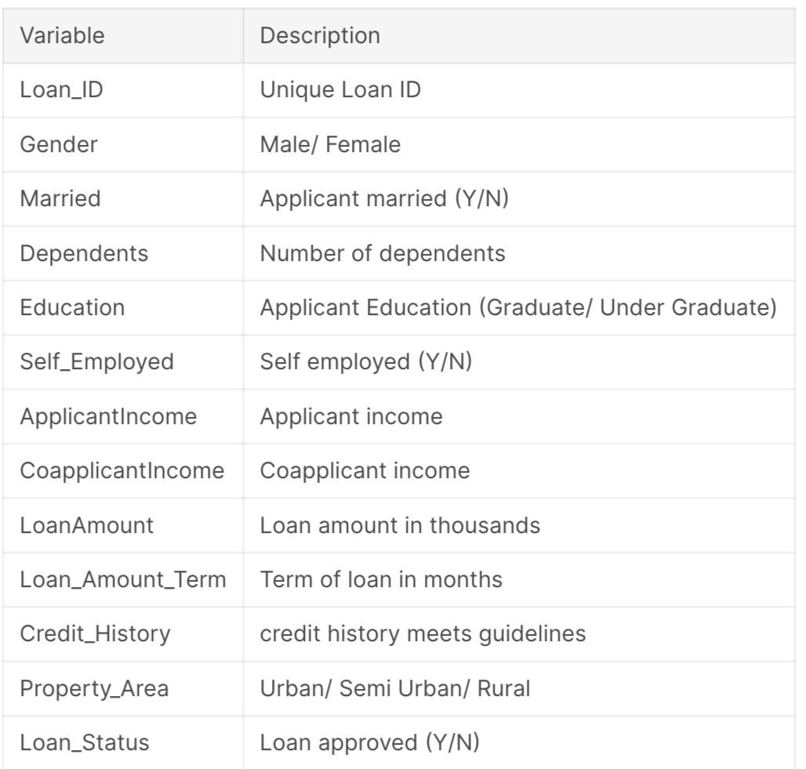
Feature Engineering
Data Description
Data Cleaning
formatted to binary data
splitted a large feature into subfeatures.
used Median value filling the missing content
applied f to filter data.

Slide 4
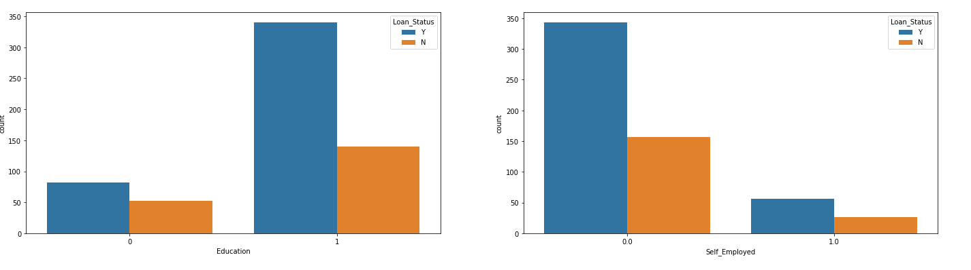
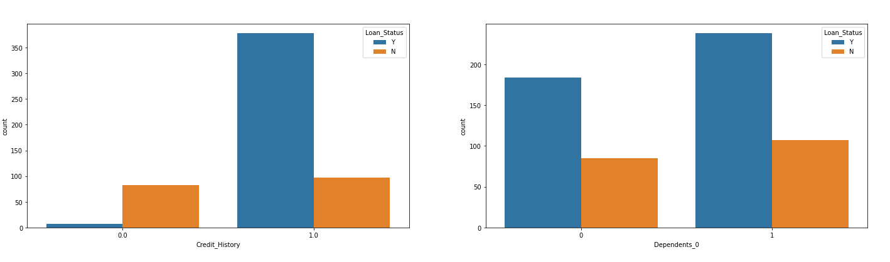
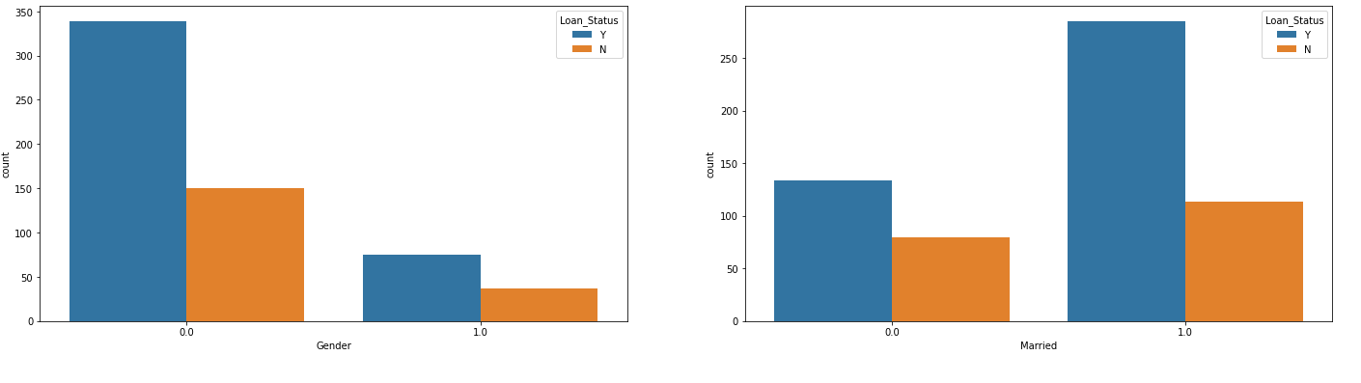
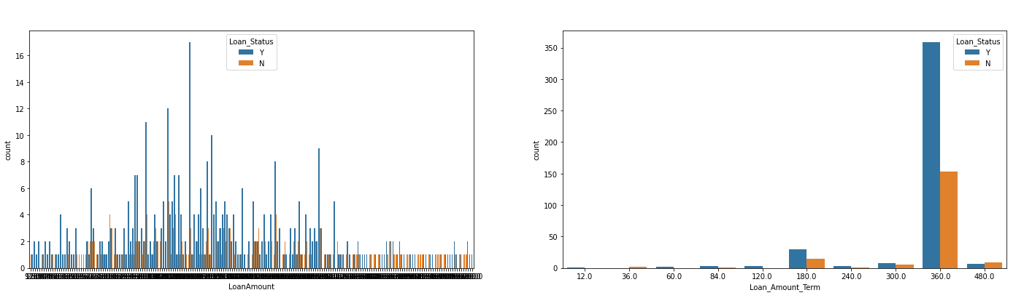
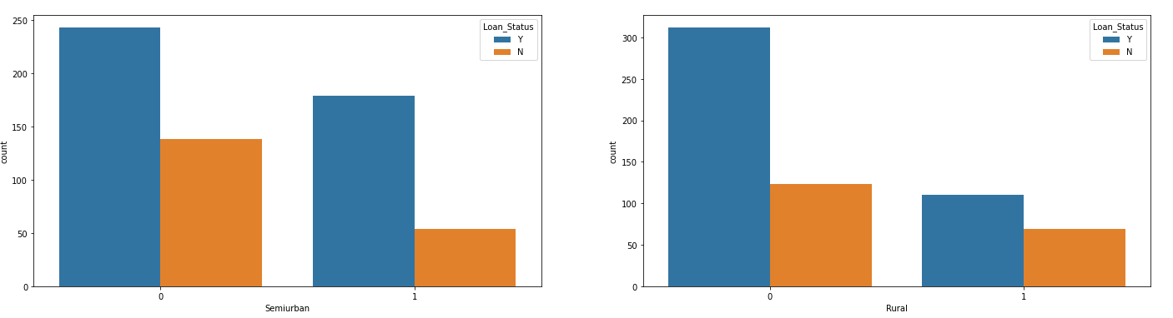
Feature Engineering
Data Visualization

Slide 5
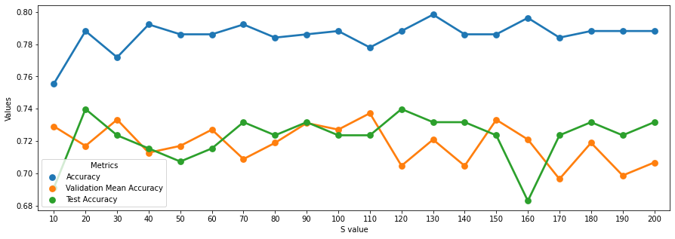
Early Stage Model Results
Random Forest

Slide 6
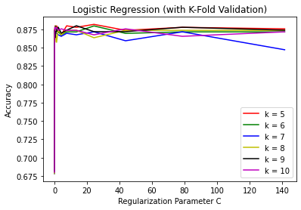
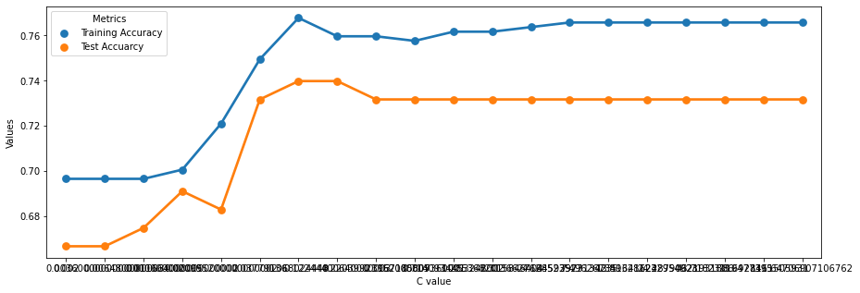
Early Stage Model Results
Logistic Regression
K-fold cross-validation
Hyperparameter Tuning : reduce overfitting
Estimate the skill of the model

Slide 7

Can we do better in the accuracy?

Slide 8
Feature Creation
From data distribution, we can see the features have a different level of impact on the outcome.
The applicant who has a good credit history looks more related to the applicant’s loan status.

Slide 9
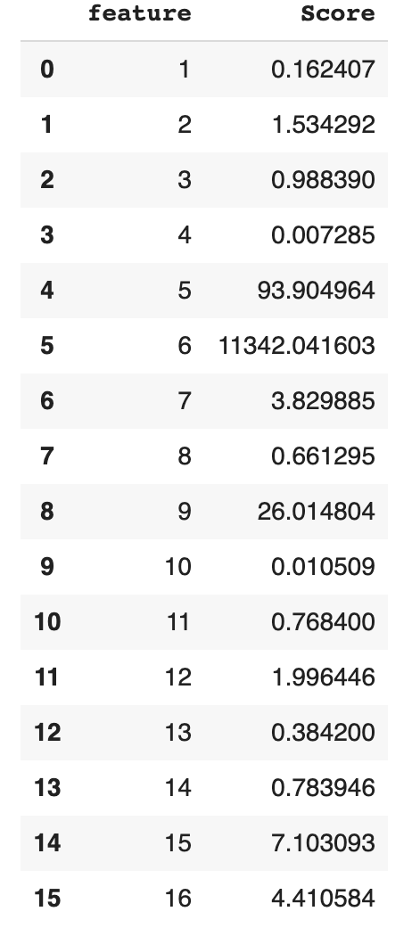
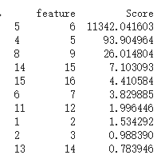
Feature Creation and Feature Selection
Before creating any features:
Univariate Selection Lists the scores performance of each independent features.
Chi Square -> calculate scores
higher score -> more important features

Slide 10
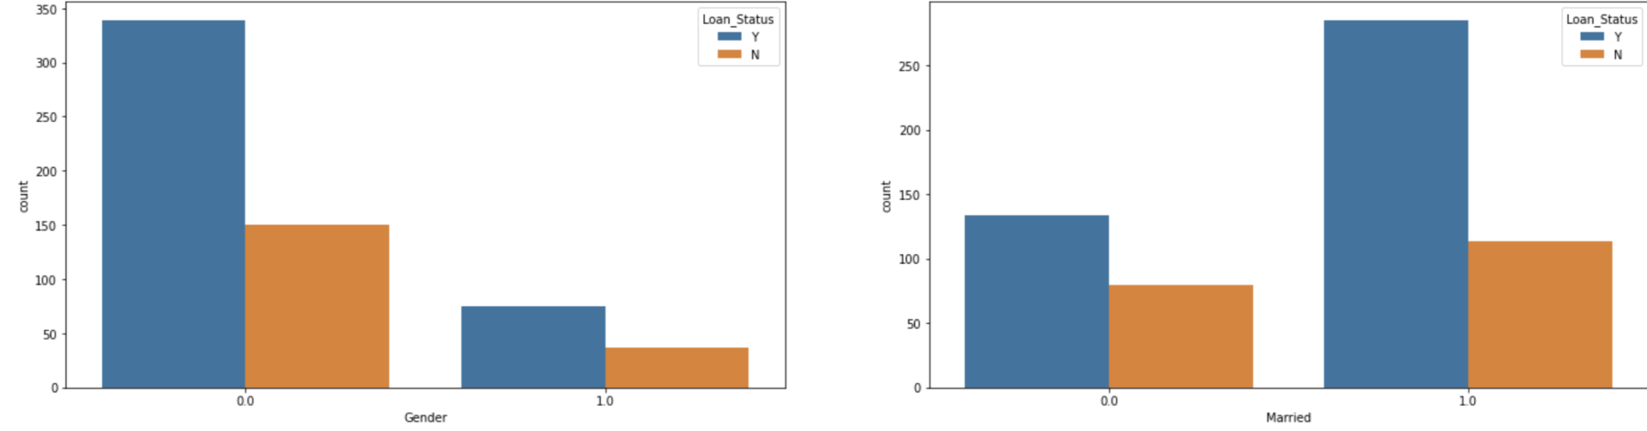
Feature Creation and Feature Selection
Questions to think about:
Does the applicant have an equal right to have the loan plan? i.e Do we see any discriminations in the dataset? Not Really
Do we have a sufficient amount of features? No
0 = not married,
1 = married
0 = male, 1 = female
Not Really

Slide 11
Feature Creation and Feature Selection
Feature Creation
-- Feature construction combines existing features and creates a new one based on the combination.
-- After the combination, the new feature will not be independent. It is dependent features instead.
Can we combine the dependent features?
Yes!

Slide 12
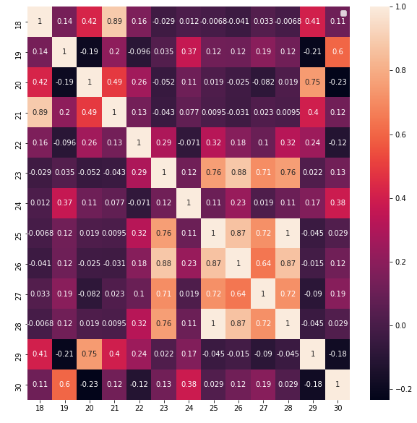
Feature Creation and Feature Selection
Correlation Matrix with HeatMap
-- inbuilt class Seaborn,sns
-- Correlation between two features
-- Absolute value <= 1
-- if value > 0.2, worth for selecting
-- create more features based on the map

Slide 13
Feature Creation and Feature Selection
# of feature = size of dataset / 20
Ideally we need 30 - 35 features regarding the size of data.
need dimension reduction.
It turns out ,we need feature selection
Selecting The Best Subset:
1.Chi Square
2. ANOVA Test
3. Correlation coefficient
we used Chi Square in Univariate Selection.
Set Of All Features
Selecting The Best Subset
Machine Learning Algorithm
Filter Method
Performance

Slide 14
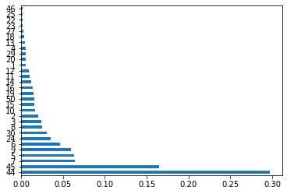
Feature Creation and Feature Selection
How do we think about choosing this subset?
By Feature Importance method:
importances of each feature of dataset
inbuilt class: TreeBased,
use Extra Tree classifier to select top 30 features
and rerun the model.

Slide 15
Feature Creation and Feature Selection
Feature Selection
Motivations:
Redundant features highly correlated features contain duplicate information example: purchase price and sales tax paid
Irrelevant features contain no information useful for discriminating outcome example: student ID number does not predict student’s GPA
Noisy features signal-to-noise ratio too low to be useful for discriminating outcome example: high random measurement error on an instrument

Slide 16
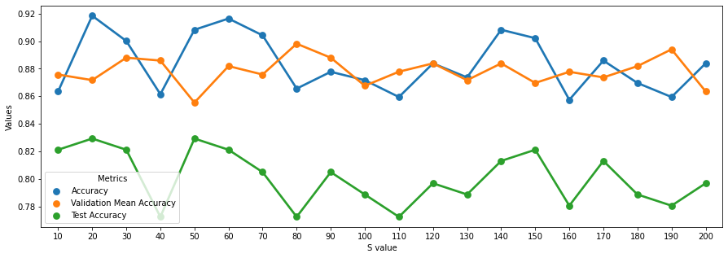
Random forest
highest accuracy(0.74)
before feature creation & feature selection
highest accuracy(0,83)
after feature creation & feature selection

Slide 17
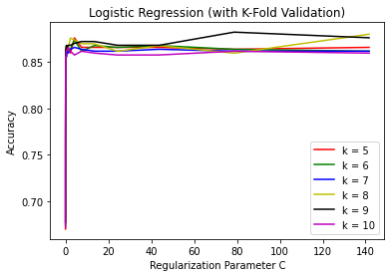
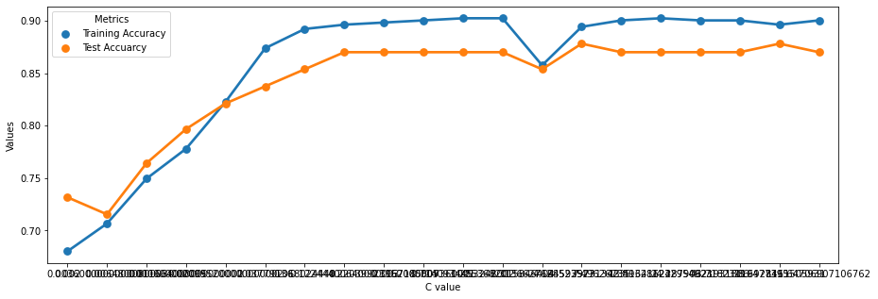
Logistic regression
underfitting
overfitting
highest accuracy
before feature creation & feature selection
underfitting
highest accuracy
after feature creation & feature selection

Slide 18
Roc Curve
predicted value
 | positive | negative
positive | TP (true positive) | FN (false negative)
negative | FP (false positive) | TN (true negative)
TPR(True positive rate) =TP / (TP + FN)
FPR(False positive rate) = FP / (FP +TN)
observed value

Slide 19
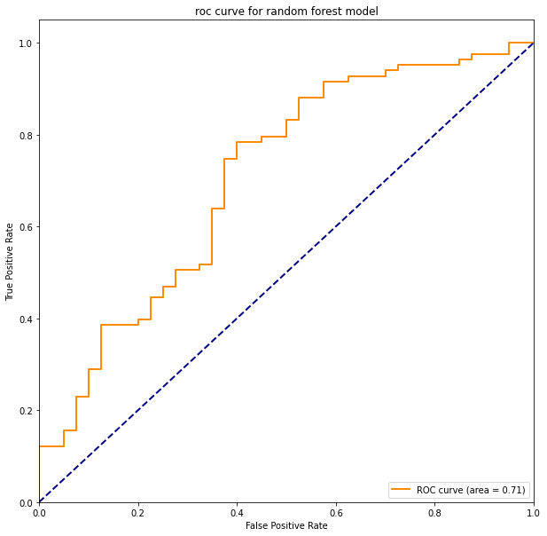
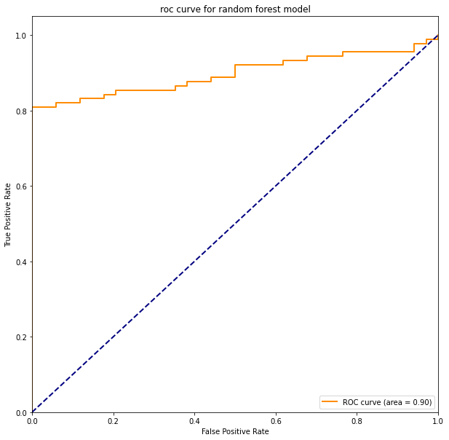
ROC curve for random forest model
ROC curve before feature creation & selection ROC curve after feature & selection

Slide 20
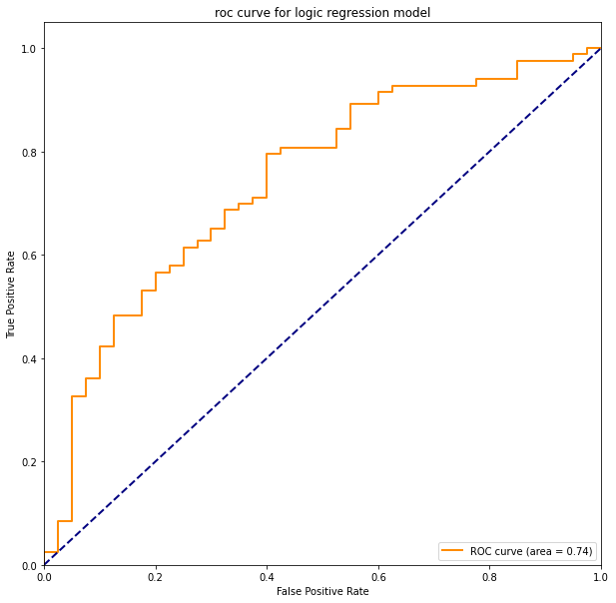
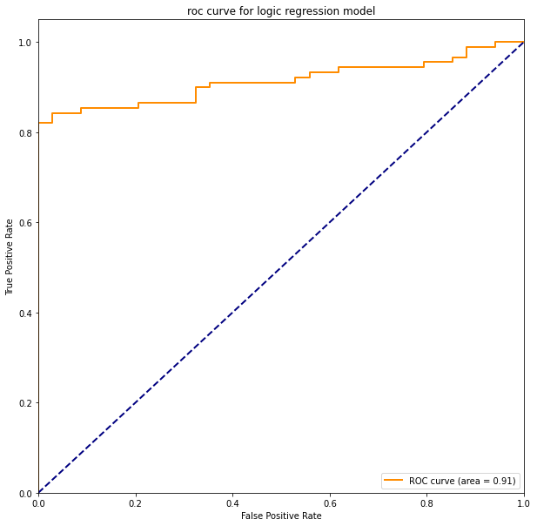
ROC curve for Logistic regression model
ROC curve before feature creation & selection ROC curve after feature creation & selection

Slide 21
7. Discussion & Continued work
How to handle numeric inputs(such as Applicant income, loan amount, etc) in dataset
Does the feature have overlapping issues?
What are the reasons causing the dependant features less important or relevant than the independent features?
We need to apply AIC to select model in future.

Slide 22
Thank you !

